Slide 1
KOKOpoint Calibration Training

Slide 2
Abbreviations
Legal metrology terms
Dispenser Design Overview
Standards overview
KP Compliance
KP Flowmeter Pulses
KP Calibration/Re-calibration
KP Sealing Process
KP Accuracy Mobile App

Slide 3
Objective
This training guide is intended for use when training technical personnel in readiness for joining the KP Calibration Team.

Slide 4
List of Abbreviations
KNK- KOKO Networks Kenya
KP- KOKOpoint
KPC- KOKOpoint Controller
SG- Systems Group Ltd
W&M- Department of Weights and Measures

Slide 5
Terms and Definitions
Legal metrology: The application of legal requirements to measurements and measuring instrument.
Custody transfer: Change of ownership of goods between two parties for a transaction
Custody transfer measuring instrument: An instrument used in transactions that involve money either for business or taxation.
Calibration: This is an operation that, under specified conditions, in a first step,establishes a relation between the quantity values with measurement uncertainties provided by measurement standards and corresponding indications with associated measurement uncertainties and, in a second step, uses this information to establish a relation for obtaining a measurement result from an indication.
Note: Often, the first step alone in the above definition is perceived as being calibration.
Sealing: Suitable securing of a component or parameter to deter tampering /unauthorized access or provide evidence of tampering or unauthorized access.

Slide 6
Legal metrology terms
Calibration device: A device/provision in an instrument for performing a calibration.
Verification: Operation carried out by an inspector/authorized personnel to ascertain and confirm that a measuring instrument entirely satisfies the requirements of the Weight & Measures Act.
Maximum Permissible Error(MPE): The extreme values of an error as specified in the Weight & Measures Act governing measuring instruments;
Authorised Technician/Personnel: Person that is allowed to perform specified activities on legally controlled measuring instrument under the applicable national laws.
Minimum Measured Quantity(MMQ):Smallest quantity of liquid for which the measurement is metrologically acceptable for that system
OIML: Organisation Internationale de Métrologie Légale (International Organization of Legal Metrology)
Traceability: Unbroken chain of comparison relating an instrument to a known standard
Type Approval: Testing, approval and certification of an equipment type in line with legal metrology standards

Slide 7
Legal metrology terms
Checking Facility: Facility incorporated in a measuring system which:
• Checks for the presence of a necessary device,
• Enables an incorrectness in the generation, transmission, processing and/or indication
of a measurement data to be detected and acted upon, and
• Enables significant faults to be detected and acted upon.
Non-Automatic checking facility(Type N): Requires the intervention of an operator.
Automatic Checking Facility: Operates without the intervention of an operator.
Permanent Automatic Checking Facility( Type P): Operates during the entire measurement operation.
Intermittent Automatic Checking Facility( Type I): Operates at least once, either at the beginning or at the end of each measurement operation.
Measuring system: A unit or combination of a meter, delivery point and hydraulic path.
Ancillary devices: Additions to the measuring system i.e calculator, display.
Fuel dispenser: Liquid measuring instrument which has a meter or one or more measuring chambers with a maximum rate of delivery not exceeding 100L/min.

Slide 8
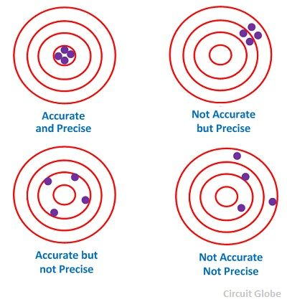
Legal metrology terms
Accuracy vs Precision
Accuracy
Closeness of a measured value to the standard value
Precision
Closeness of repeated measured values to one another
Error in a dispense
En= [(Vi-Vn)/Vn] x 100
Accuracy Class: Classification of equipments into categories according to application used for derivation of the required dispense accuracy

Slide 9
Metrological Requirements for Dispensers
The OIML R117-1 stipulates the requirements for fuel dispensers intended for custody transfer.
These requirements touch on;
Design of the equipment to meet metrological requirements.
Assembly and component connections.
Dispense accuracy adherence to equipment class MPEs.
Protection of legally relevant metrological components in the equipment.
Protection of legally relevant metrological parameters if an equipment if software operated.
Type Approval testing and certification.
Initial verification and subsequent verification requirements.

Slide 10
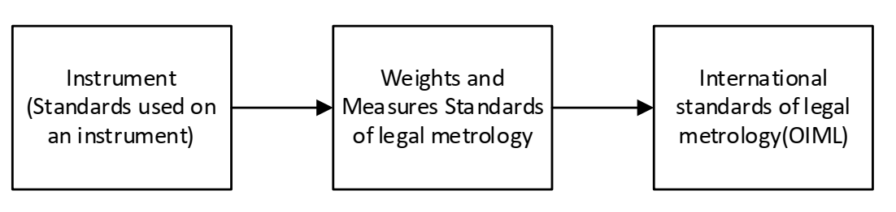
Standards Overview
Legal metrology in Kenya is guided by the Weights and Measures Act Cap 513 which is derived from the OIML recommendations.
OIML R117-1, OIML R117-2, OIML R117-3 is the recommendation adopted for dispensers and the KP design is based on these recommendations.
Traceability chain in Kenya

Slide 11
KP Compliance
The KP is designed to meet the metrological requirements in the following ways;
Design
-Checking facilities (Automatic Type P), no-air-intake plumbing system, fully primed system, calibratable, controlled access to KP components.
Physical sealing provisions on the calibration module and meter connector.
Software protection.
- passwords & privileges, audit trails, firmware verification(CRC/hash), software ID, secure servers.
KPC and flowmeter are Type Approved.
Has a Type Approval Name Plate.

Slide 12
KP Compliance cont’d...
The following KP elements are metrologically relevant and are subject to legal control
Flowmeter.
Calibration module.
KPC firmware (handles legally relevant parameters - pulses, price and volume computations, computations and processes).
KP Dispense Volumes MPE’s
Volume(ml) | MPE(%) | MPE(ml)
300 | ±2% of 0.4L | ±8
500 | ±2% | ±10
1000 | ±2% | ±20
1500 | ±1% of 2L | ±20
2000 | ±1% of 2L | ±20

Slide 13
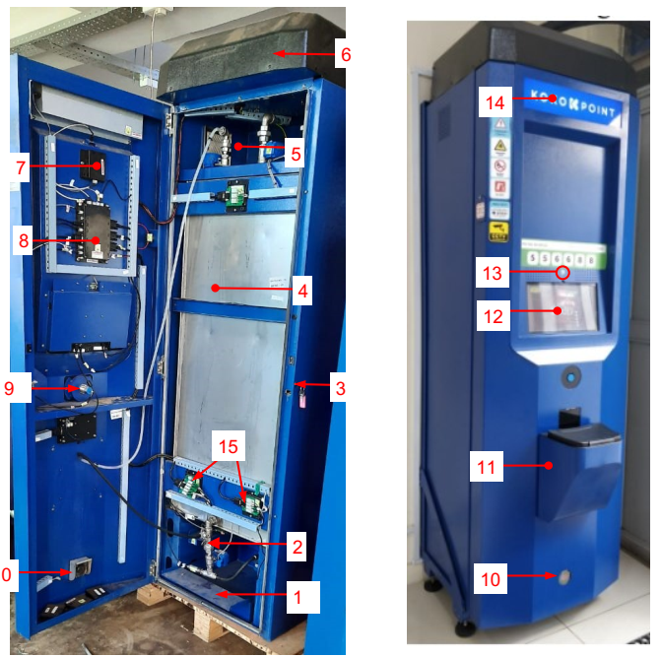
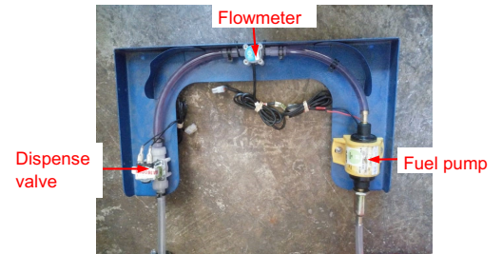
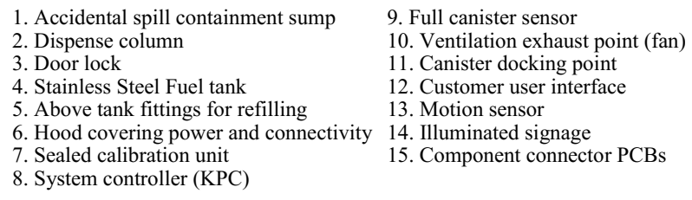
KP Parts Overview

Slide 14
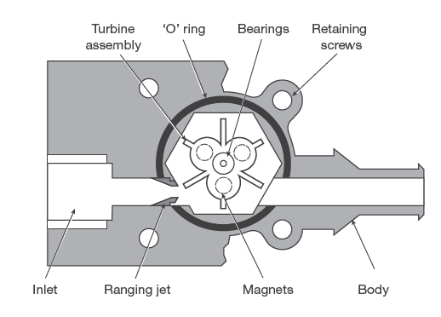
KP Flowmeter Pulses
KP uses Titan Series 845 turbine flowmeter
Fuel passing through the flowmeter causes rotation of the turbines (with magnets). The turbine rotation is picked up by a hall effect sensor which translates it into pulses.
To achieve accurate dispenses, the respective pulses for the KP pre-set dispense volumes are adjusted via the calibration interface.

Slide 15
KP Calibration/Re-calibration
KP calibration is based on iteration of a preset volume while adjusting the equivalent pulses to achieve the desired accuracy
Key points
Wetting standards, leveling standards, avoiding spills & reading errors and analyzing data
Events that may lead to KP calibration
After deployment before customer use.
Change of flowmeter
Change of calibration PCB module.
Lapse of required re-calibration period.
Upon proof that the KP has lost accuracy - periodic or after change of components.
Main sources of errors during KP calibration
Parallax errors
Canister/smart valve inconsistency
Improper use of measuring equipment Detailed KP calibration procedure

Slide 16
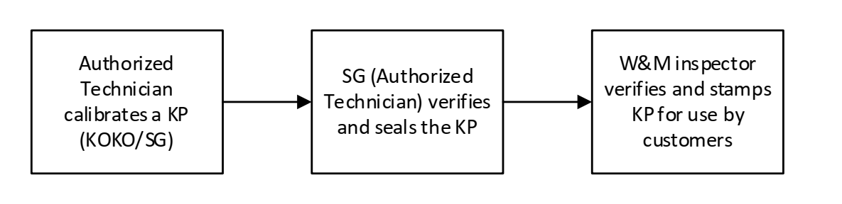
KP Sealing Process
The following process leads to a KP being authorized for customer use by the Weights and Measures (sealing)

Slide 17
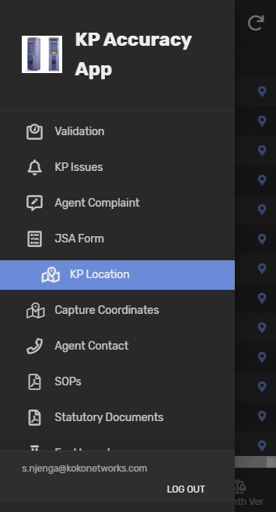
KP Accuracy Mobile App
Makes the KP accuracy process paperless
Accuracy processes covered by the mobile app include;
KP calibration
KP dispense accuracy verification - 3 months and any other verification
The app offers other details which include;
KP location
KP calibration pulses linearity
Agent contacts and complaints capturing
KP issues experienced during an accuracy process
Necessary work documents
Detailed KP Accuracy Mobile App Instructions

Slide 18
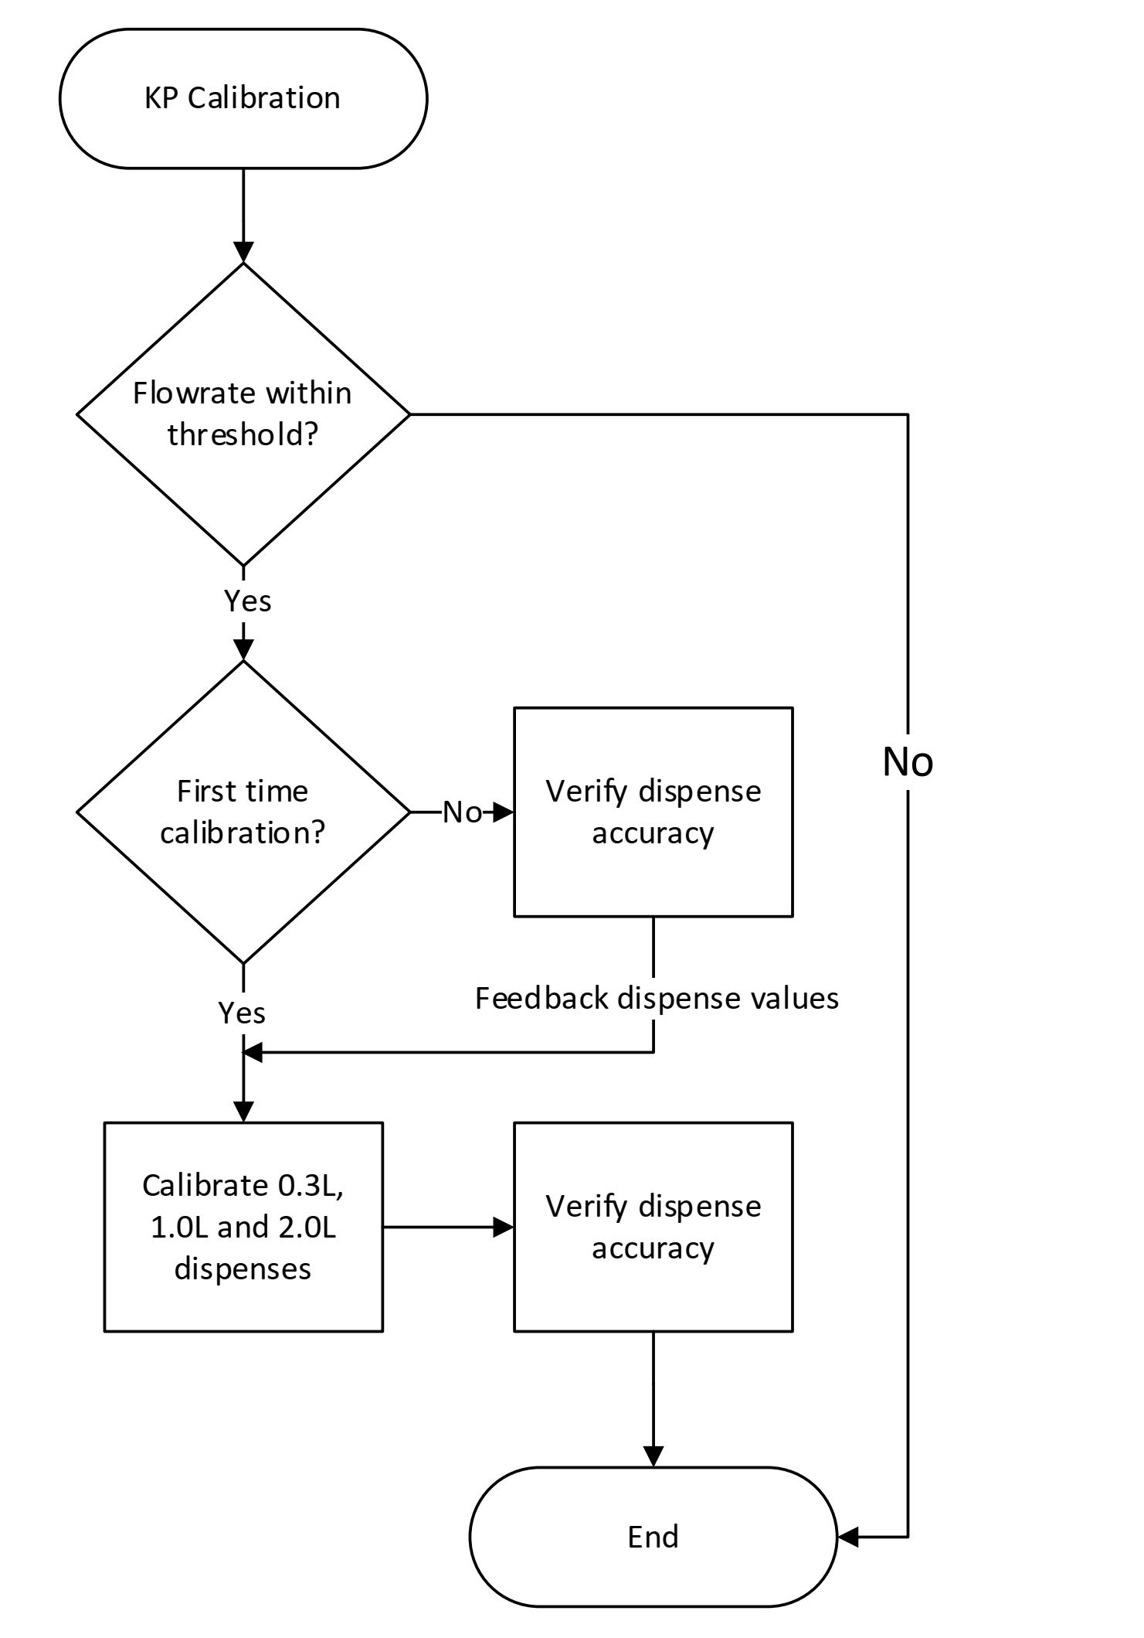
Appendix: KP Calibration Flowchart

Slide 19
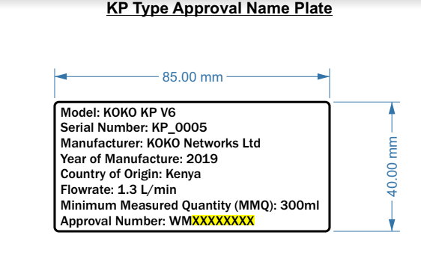
Appendix: KP Type Approval Plate

Slide 20
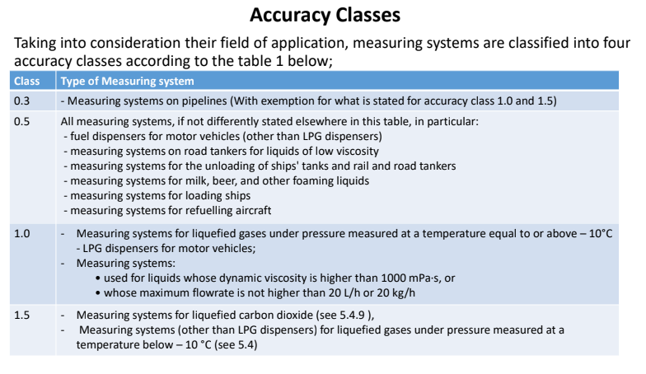
Appendix: Accuracy Classes

Slide 21
Appendix: KPC Firmware ID
KPC.A.B.C
Where;
A represents the version of the controller board
B represents the legally relevant part of the controller firmware
C represents the non legally relevant part of the controller firmware
i.e KPC 4.2.1

